Slide 1
Murach’s ASP.NET Core MVC (2nd Ed.)
Chapter 18
How to use Visual Studio Code

Slide 2
Objectives (part 1)
Applied
Use Visual Studio Code to create and work with ASP.NET Core MVC web apps.
Knowledge
Distinguish between Visual Studio Code and Visual Studio.
Describe how to use VS Code to open and close a folder for an existing Visual Studio project.
List and describe the three modes Visual Studio Code provides for viewing and editing files.
Describe how to use VS Code to run an ASP.NET Core project.
Describe how to use the CLI to execute the EF Core commands.
Describe how to use the CLI to create a new ASP.NET Core MVC web app and add NuGet packages to it.

Slide 3
Objectives (part 2)
Describe how to use VS Code to work with the folders and files of a project.
Describe how to use the CLI to install and manage client-side libraries.
Describe how to use VS Code to debug a web app.

Slide 4
How to open a project folder
Select File→Open Folder from the menu system.
Use the resulting dialog to select the folder that contains the Visual Studio project. For the Future Value app from chapter 2, you can select this folder:
\murach\aspnet_core_mvc\book_apps\Ch02FutureValue\
FutureValue
3. Click Select Folder.
How to close a project folder
Select File→Close Folder from the menu system.

Slide 5
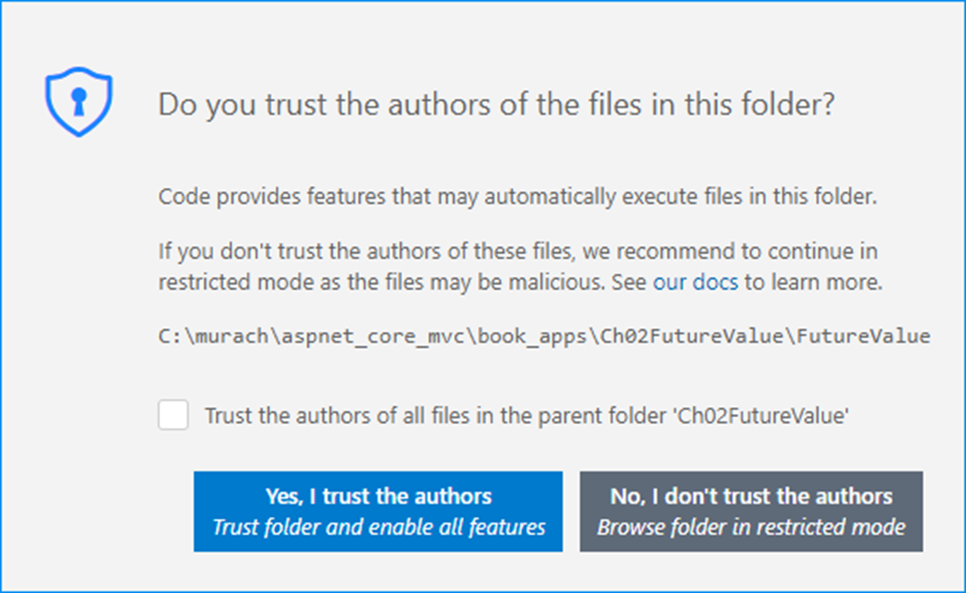
A typical message after opening a Visual Studio project

Slide 6
How to deal with errors and messages after opening a Visual Studio project
If you get a dialog asking if you trust the authors, click “Yes, I trust the authors”. You can also check the “Trust the authors…” checkbox to avoid this message in the future.
If you get a dialog that indicates that “Required assets to build and debug are missing” and asks if you would like to add them, click Yes. This adds a .vscode subfolder to your project folder that contains .json files with VS Code configurations.
If you get a dialog that says “There are unresolved dependencies”, click Restore.
If VS Code still displays messages, including underlined code, close VS Code and start it again. The problems should go away when VS Code rereads its configuration files.

Slide 7
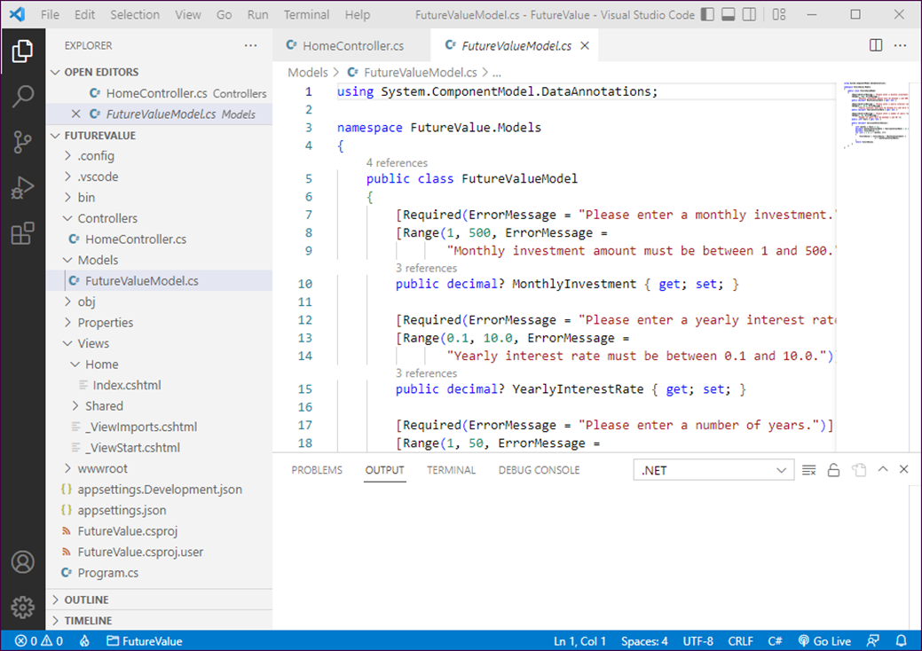
VS Code with files in Standard and Preview Modes

Slide 8
Three modes for viewing files
Mode | Useful for…
Preview | Switching between files to quickly view them.
Standard | Opening a file indefinitely for viewing and editing.
Zen | Focusing on editing a file’s code without distraction of other interface elements.

Slide 9
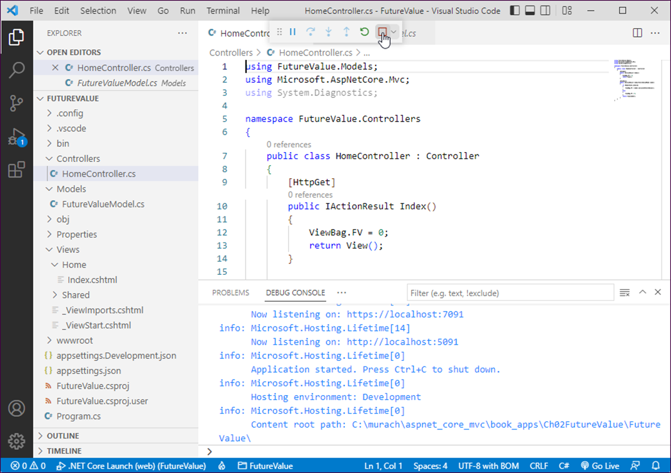
VS Code with an app running

Slide 10
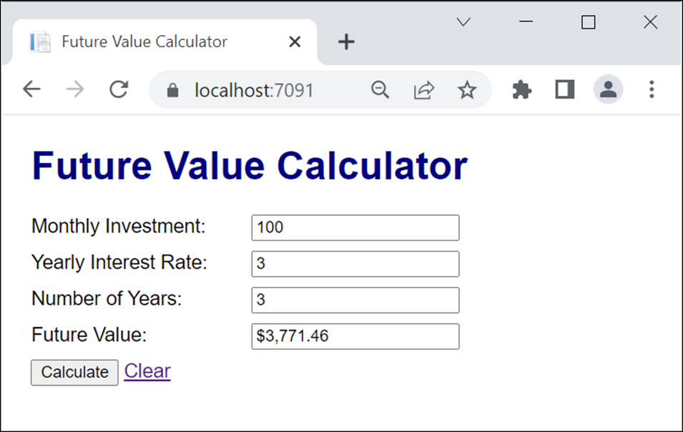
The app in a browser

Slide 11
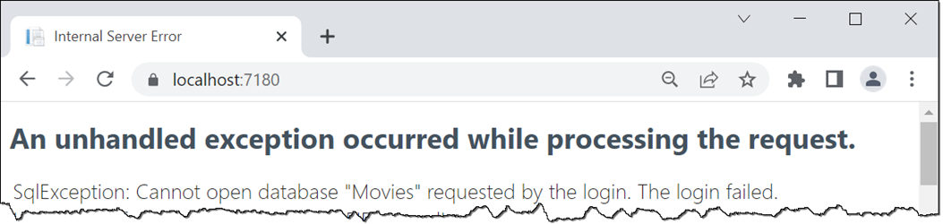
The error message that’s displayed if the database hasn’t been created

Slide 12
How to install the CLI tools for .NET EF Core
Display the Terminal by selecting Terminal→New Terminal.
At the command prompt, enter this command:
dotnet tool install --global dotnet-ef

Slide 13
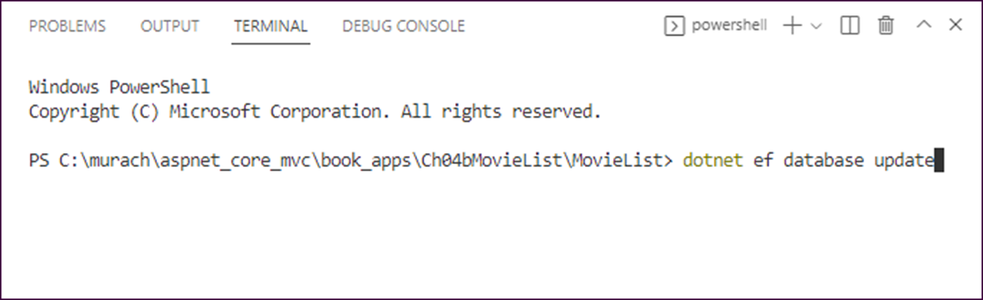
A command prompt for the Ch04MovieList app
How to create the database for a project
Display the Terminal by selecting Terminal→New Terminal.
At the command prompt, enter this command:
dotnet ef database update

Slide 14
A command that installs the CLI tools for .NET EF Core
dotnet tool install --global dotnet-ef
Some of the .NET EF Core commands (prefix with dotnet ef)
migrations add
migrations remove
database update
database drop
dbcontext scaffold

Slide 15
Two commands that add migrations
dotnet ef migrations add Initial
dotnet ef migrations add Genre
A command that updates the database to the last migration
dotnet ef database update
A command that updates the database to the specified migration
dotnet ef migrations update Initial
A command that removes the last migration
dotnet ef migrations remove
A command that drops the database
dotnet ef database drop

Slide 16
A command that generates DB classes from an existing database
dotnet ef dbcontext scaffold name=BookstoreContext Microsoft.EntityFrameworkCore.SqlServer
--output-dir Models/DataLayer --data-annotations --force

Slide 17
How to create a new project for an ASP.NET Core MVC web app
Use your operating system to create a new root folder for your project.
Start VS Code.
Select File→Open Folder and use the resulting dialog to select the root folder for the project.
Select Terminal→New Terminal to open a Terminal window.
Enter the following command:
dotnet new mvc

Slide 18
Templates for creating ASP.NET Core projects
Template name | CLI argument
Web App (Model-View-Controller) | mvc
Empty | web

Slide 19
How to use the CLI to add NuGet packages for EF Core
dotnet add package Microsoft.EntityFrameworkCore.SqlServer
dotnet add package Microsoft.EntityFrameworkCore.Design

Slide 20
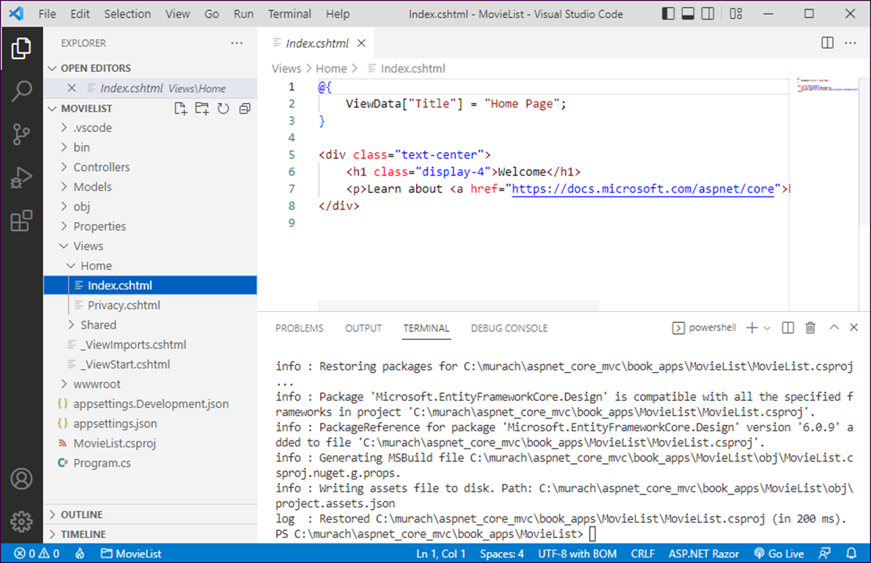
VS Code with a project created from the MVC template

Slide 21
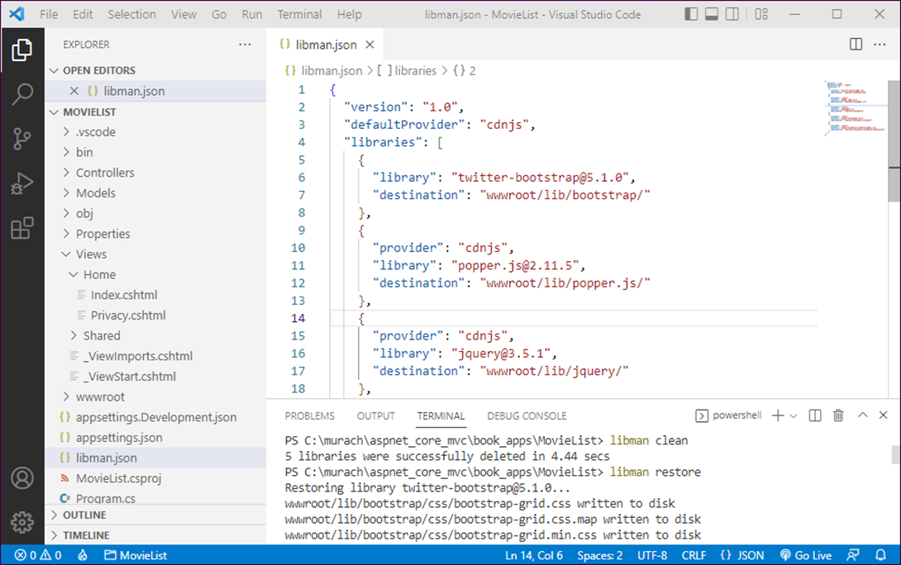
VS Code using the CLI tools for LibMan to install client-side libraries

Slide 22
A command that installs the CLI tools for LibMan
dotnet tool install --global Microsoft.Web.LibraryManager.Cli
How to create a libman.json file for a project
At the Terminal command prompt for the project, enter this command:
libman init
Press Enter to accept the default provider of CDNJS.

Slide 23
How to use LibMan to install client-side libraries
Open the libman.json file and edit it to include the client-side libraries you want to install as described in chapter 3.
At the Terminal command prompt, enter this command:
libman restore
How to delete all client-side libraries installed by LibMan
At the Terminal command prompt, enter this command:
libman clean

Slide 24
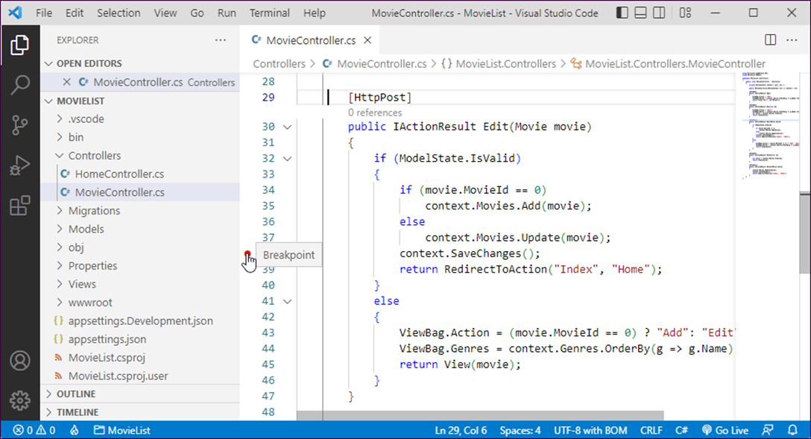
The Movie controller with a breakpoint

Slide 25
How to set and remove breakpoints
To set a breakpoint, click in the margin indicator bar to the left of the line number for a statement. This highlights the statement and adds a breakpoint indicator (a red dot) in the margin.
To remove a breakpoint, click the breakpoint indicator.
To remove all breakpoints, select Run→Remove All Breakpoints.

Slide 26
How to enable and disable breakpoints
To disable a breakpoint, right-click it and select Disable Breakpoint.
To enable a breakpoint, right-click it and select Enable Breakpoint.
To disable all breakpoints, select Run→Disable All Breakpoints.
To enable all breakpoints, select Run→Enable All Breakpoints.

Slide 27
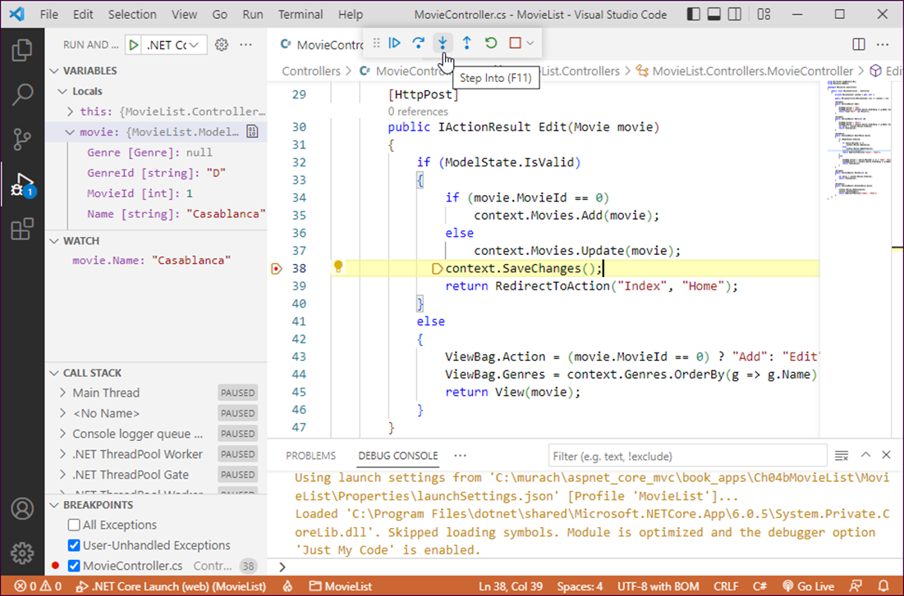
The Movie List app in break mode

Slide 28
Two ways to run an app with debugging
Press F5.
Select Run→Start Debugging.

